Slide 1
High-Precision Gesture Tracking
Privacy-Protected Interface with Rolling Shutter & LED Gloves
Presenters:
Soham Naik & Deniz Acikbas
3rd Team Member:
Zaynab Mourtada
Date:
9/18/2024

Slide 2
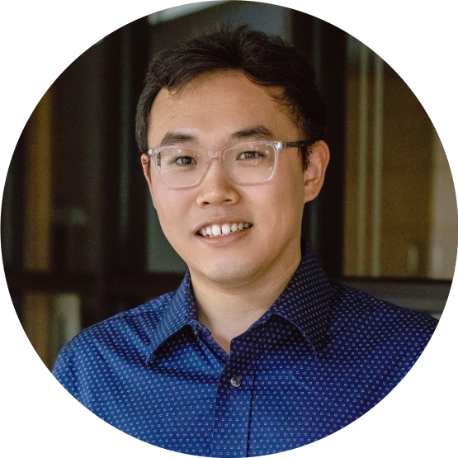
Meet The Client
Client: Dr. Xiao Zhang
Research Interests:
Mobile Computing, AIoT, Cyber Physical Systems, AI-assisted sensing/localization, and HCI
Background:
Postdoctoral Associate at Duke University.
Ph.D. degree in the Computer Science and Engineering at Michigan State University
M.S. degree at Northwestern Polytechnical University
B.E. degree with honor at Taiyuan University of Technology.
Personal Website: https://www.zhangxiao.me/#home

Slide 3
Project Overview
Objective:
Develop a mobile app to stabilize, smooth and recognize finger gestures captured by the rolling shutter cameras of smartphones, reconstructing them in a 3D environment for use in diverse applications.
Approach:
Leverage rolling shutter cameras and LED-equipped gloves to track and reconstruct 3D finger movements in real-time, correcting distortions.
Scope:
Overcome limitations of existing gesture tracking technology for enhanced precision and usability for handwriting and gestures.

Slide 4
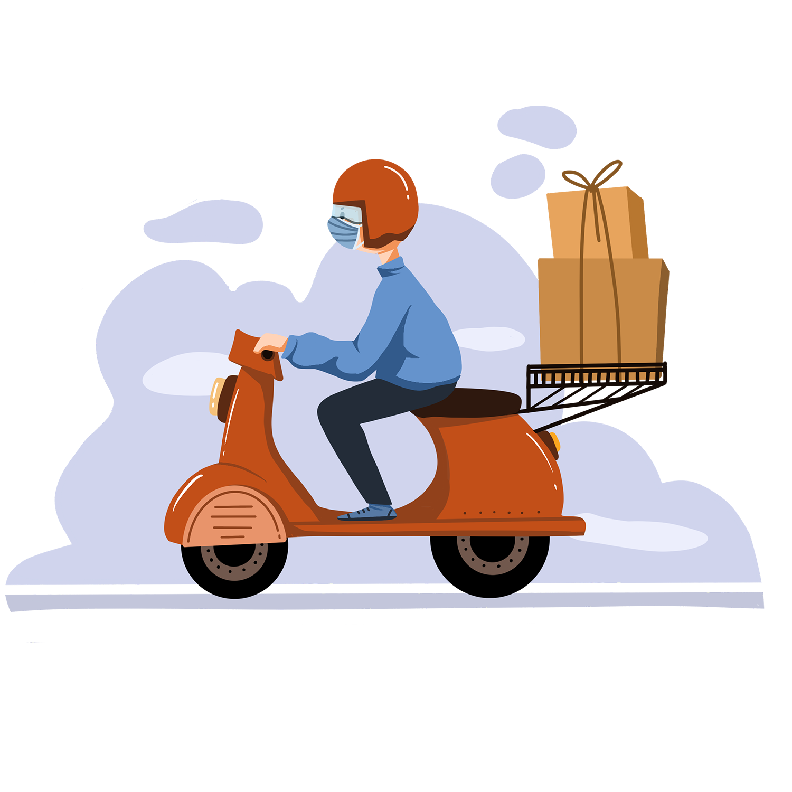
Deliverables
High-Precision Gesture Tracking:
Develop software for accurate finger gesture tracking.
3D Smoothing Technology:
Implement techniques to smooth and enhance gesture paths.
Mobile App Development:
Create an app for real-time tracking and processing of gestures using smartphone cameras.
Privacy Protection:
Incorporate features to filter out non-relevant information and enhance user privacy.

Slide 5
Why This Project Matters
01
02
03
04
Relevance
Skill Development
Address privacy and accuracy challenges in gesture tracking.
Rolling shutter cameras
LED tracking
Mobile App Development
Machine learning
Image processing.
Significant Impact
Publication Potential
Healthcare
Precision
Diverse Applications
Enhance your resume and research prospects with potential for official publication.

Slide 6
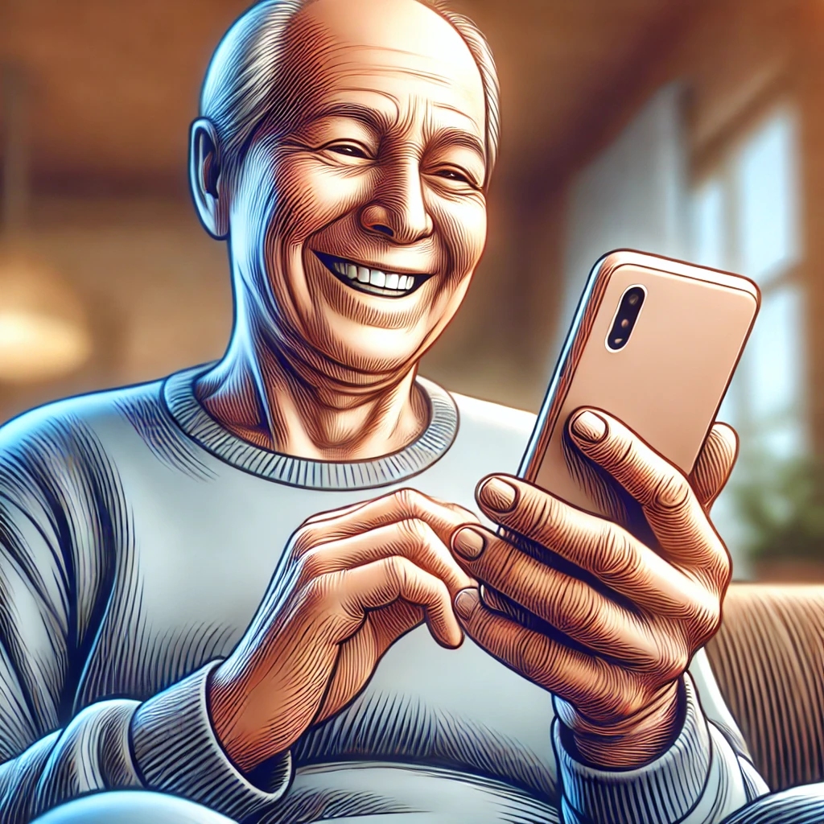
A PICTURE IS WORTH A THOUSAND WORDS
How Adaptive HCI works?

Slide 7
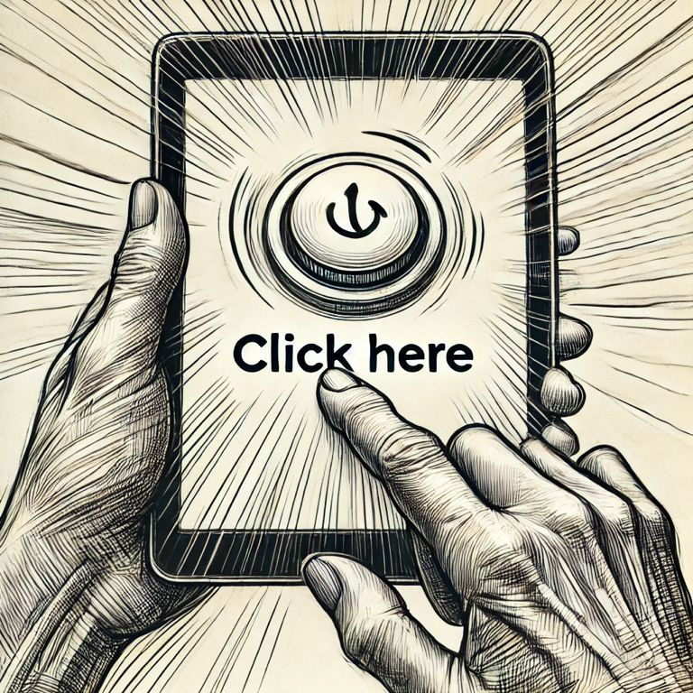
1-) The Parkinson’s patient fails to click the button.

Slide 8
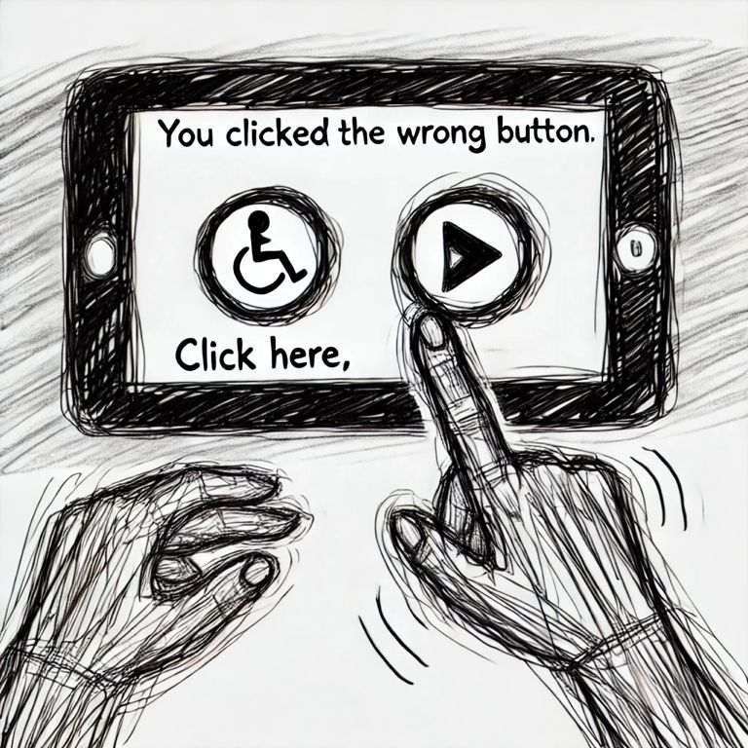
2-) The patient receives an error message.

Slide 9
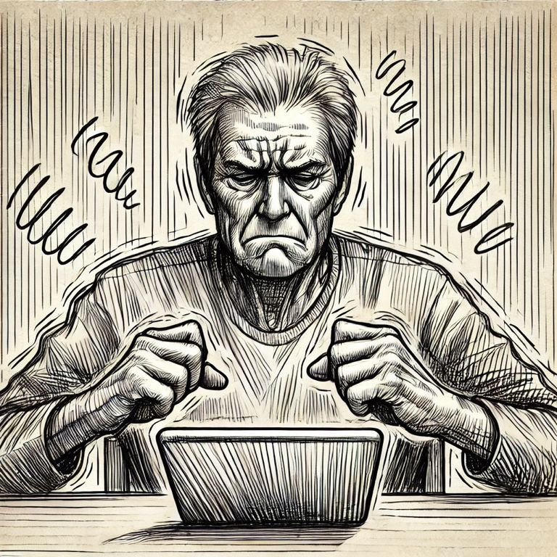
3-) The patient does not like the app.

Slide 10
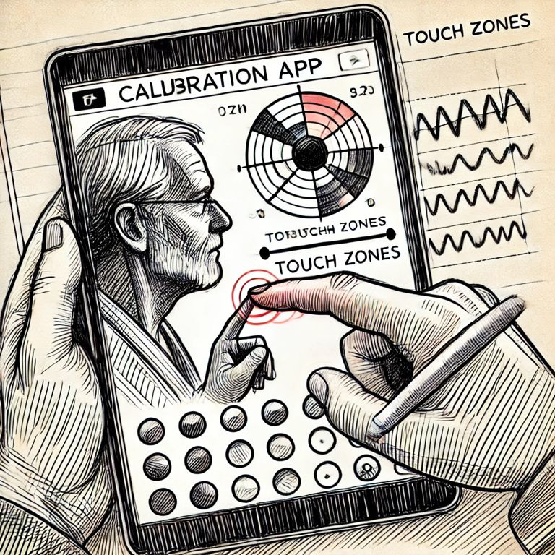
4-) The patient clicks on the calibration app to have their finger movements and face recorded.

Slide 11
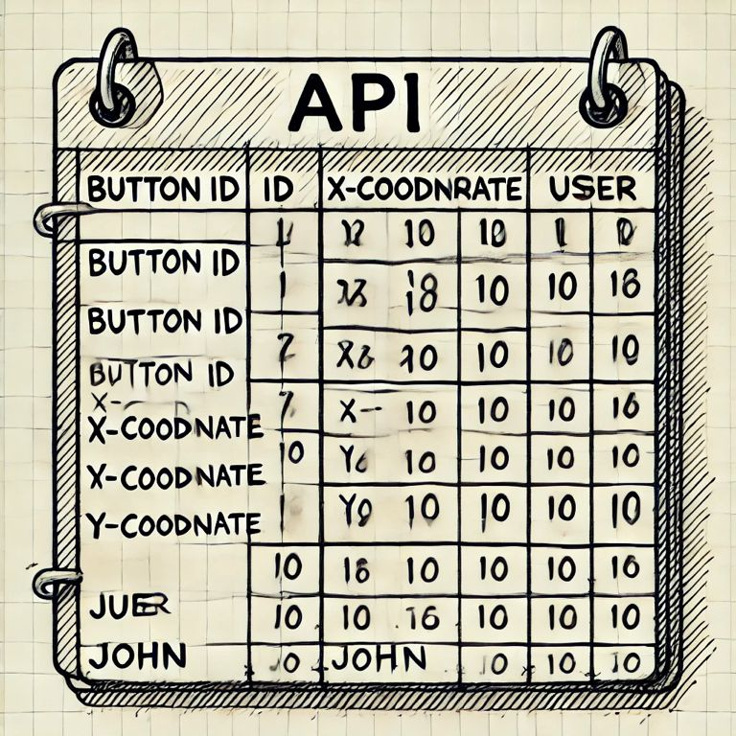
5-) The API recognizes button movements and the user ID from the table, then sends the data to the server.

Slide 12
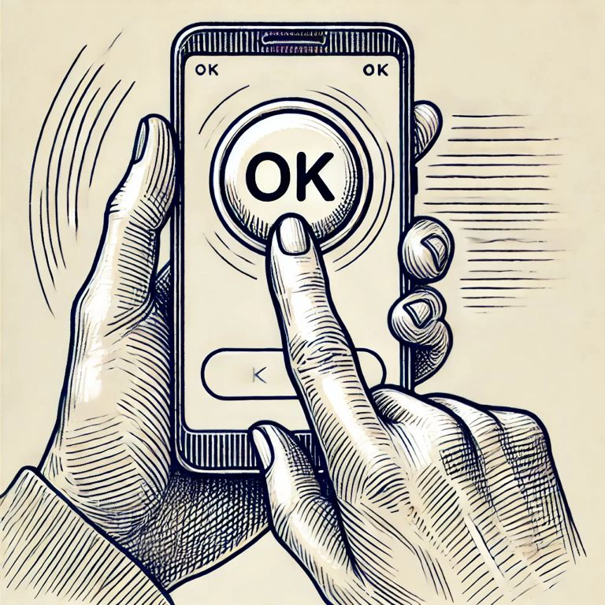
6-) The patient successfully clicks the button.

Slide 13
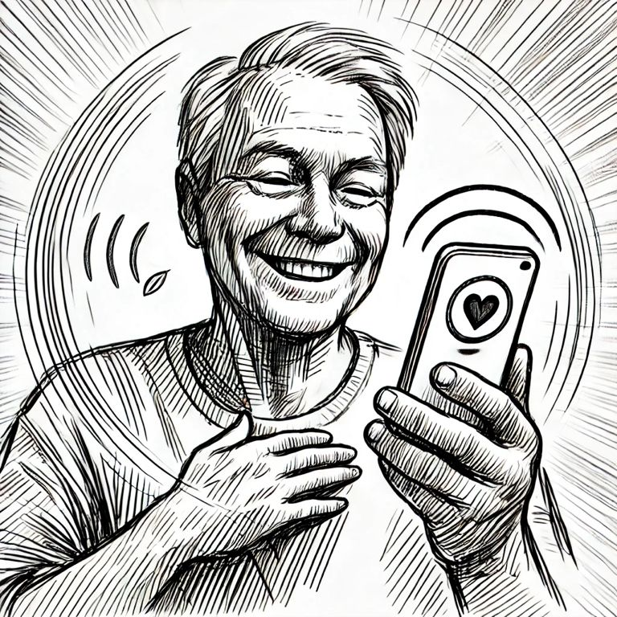
7-) The patient is satisfied with the software.

Slide 14
Seeking Individuals Passionate About
Project Management
3D Simulation
Algorithm Development
Android App Development
Unity3D, Unreal Three.js OpenGL, or Vulkan
GitHub, Hive, Microsoft Teams
Machine Learning: TensorFlow or PyTorch
Image Processing: OpenCV or SkiKit
Android Studio, Kotlin or Java, ARCore, Firebase

